Slide 1

Analysis of Cooking Sessions and User Orders By : Arihant Jain

Slide 2
Agenda
Introduction
Data Cleaning and Preprocessing
Engaging the audience
Key Insights from the Analysis
Visualizations
Conclusion

Slide 3

Introduction
This report provides insights into the relationship between cooking sessions and user orders, explores popular dishes
Identifies trends related to meal types, session ratings, and user behavior. Based on the dataset
The analysis includes time series visualizations, trend analysis, and key findings. The purpose is to derive actionable business recommendations to optimize operations and enhance user experience.

Slide 4
Data Preprocessing
Merging Data
The dataset consists of three separate sheets: User Details, Cooking Sessions, and Order Details. These sheets have been merged based on the common column User ID.
The merging process was carried out using the User ID column to ensure that all relevant user and session details are associated with each order.

Slide 5
Handling Missing Values
The Rating column in the merged dataset has missing values. These missing values were handled by replacing them with the mean value of the column.
Converting Columns to Datetime Format
The following columns were converted to the datetime format to facilitate proper analysis and time-based operations:
Order Date in the Order Details sheet.
Session Start and Session End in the Cooking Sessions sheet.

Slide 6
Checking for Duplicates:
After merging the data, it was verified that no duplicates exist within the dataset
Summary of Data Cleaning:
Merged all three sheets: User Details, Cooking Sessions, and Order Details.
Handled missing values in the Rating column by replacing them with the mean.
Convert the relevant columns (Order Date, Session Start, and Session End) to datetime format.
Verified that no duplicates were present in the dataset.

Slide 7

Key Findings(Visualization)

Slide 8
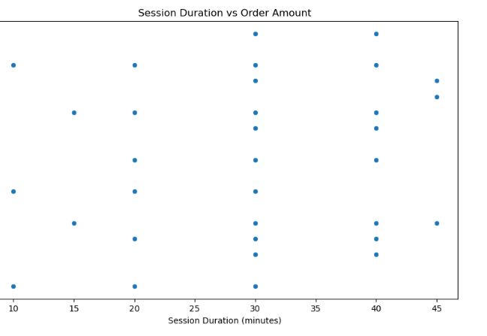
Analyze the relationship between Cooking Sessions and Orders Correlation between Session Duration and Order Amount

Slide 9
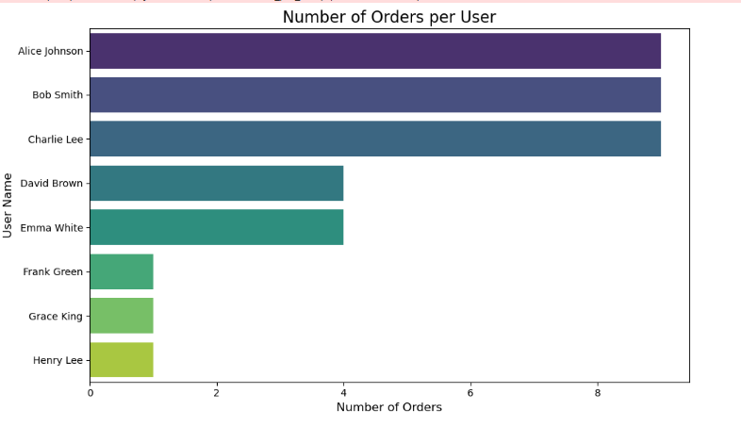
Analyze the Number of orders per user
Alice Johnson gives max Orders
The analysis revealed varying levels of engagement across users. Some users placed multiple orders, while others placed only a single order.

Slide 10
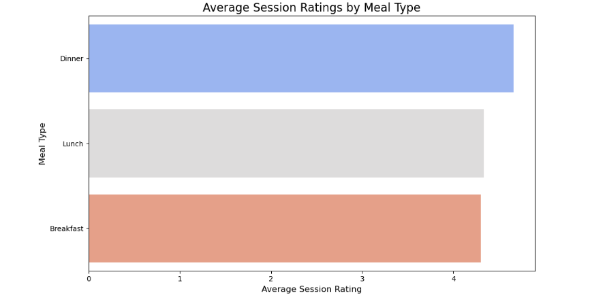
Analyze the Average Session Rating by Meal Type
The average session ratings varied by meal type.
Dinner consistently received higher ratings, reflecting customer satisfaction with those dishes.
suggesting that users tend to enjoy dinner meals more or may associate dinner with higher satisfaction due to meal complexity or quality.

Slide 11
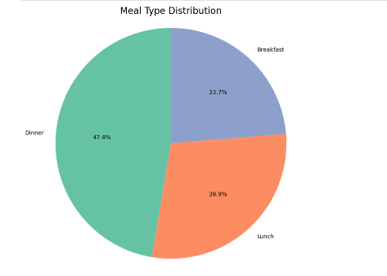
Analyze the Meal Type Distribution
The distribution of meal types showed that Dinner sessions are the most frequent, followed by Lunch and Breakfast.
The trend suggests that the peak demand occurs in the evening, with Dinner orders being the most significant revenue generator.

Slide 12
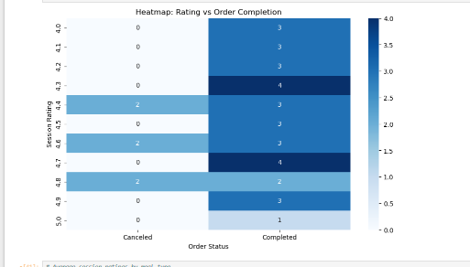
Analyze the Heatmap of Rating VS Order Completion

Slide 13
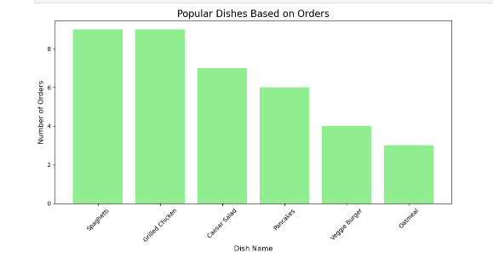
Analyze the popular Dishes based on orders
The most popular dish based on order frequency is Spaghetti, with the highest number of orders across all meal types.

Slide 14
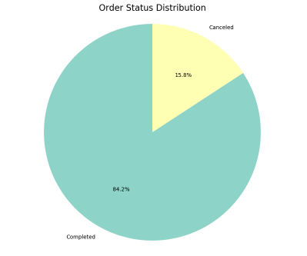
Analyze the Order Status Distribution
A significant majority of orders are marked as Completed, indicating that the order process is generally reliable and efficient.
Approximately 84.2% of all orders fall under the "Completed" category.
Most cancellations occur for dishes like Veggie Burger, which may indicate specific issues such as supply chain problems, preparation delays, or customer dissatisfaction.

Slide 15
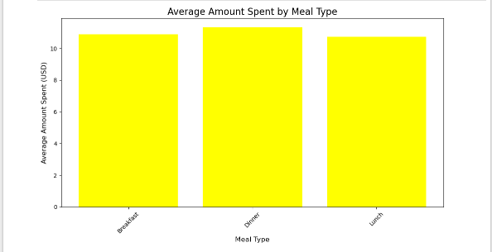
Analyze the Average Amount Spent by Meal Type
Dinner stands out as the meal type with the highest average amount spent per order.
This could be due to customers preferring premium or larger portions for dinner.

Slide 16
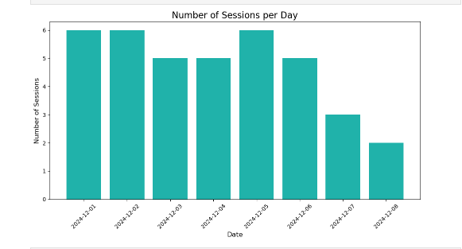
Analyze the Number of Session Per Day
The highest number of cooking sessions occurs on weekends (Saturday and Sunday).
This suggests increased user activity during leisure days when customers are more likely to dine out or order food.

Slide 17
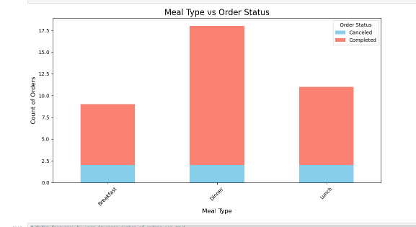
Analyze the Meal Type VS Order Status
Dinner orders show the highest completion rate compared to other meal types. This indicates that customers are more committed to completing their dinner orders, making it a key revenue-driving meal type.
Breakfast and lunch have a noticeable percentage of canceled orders. This could be due to rushed schedules during the morning and midday, where customers may change or cancel plans.

Slide 18
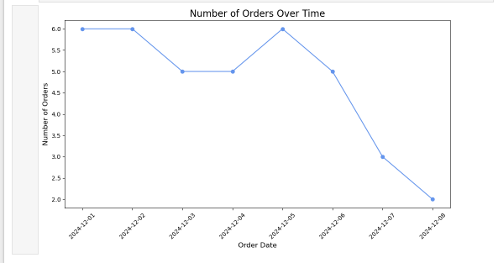
Analyze the Number of order over time
The number of orders shows a steady increase over the analyzed time period, indicating growing customer engagement with the platform.
Orders tend to increase toward the end of the week (e.g., Fridays and weekends), suggesting customers are more likely to order during leisure times or social gatherings.
Sudden spikes in order volumes may correspond to specific promotions or festive seasons. These spikes can be used to gauge the success of campaigns.

Slide 19
Business Recommendations
Target Loyal Customers : Focus on nurturing relationships with the top users who place multiple orders.
Improve Meal Offering Based on Popular Dishes: Given the popularity of Spaghetti, Caesar Salad, and Grilled Chicken. Regularly update the menu to introduce seasonal or trending dishes based on customer feedback and preferences.
Optimize Operations During Peak Hours: Since Dinner is the most popular meal type, with a significant portion of orders being placed in the evening, ensuring smooth operations and minimizing delays during these times is crucial.
increasing kitchen staff during peak hours may help reduce cancellations and improve customer satisfaction.
Enhance User Experience to Reduce Cancellations: Investigate the reasons behind higher cancellation rates during Breakfast sessions. This could be due to various factors such as delays, user preferences, or operational inefficiencies. Offering time-based discounts or incentives for completing orders may reduce cancellation rates.
Utilize Time-Based Promotions: As there is an observable pattern of increased orders during weekends and evenings, offering targeted promotions during these periods could drive higher sales. For instance, discounts or special menu items could be introduced on weekends to encourage more orders.

Slide 20
Personalized Meal Recommendations: Based on session ratings and meal types, personalized meal recommendations can be implemented to suggest meals to users based on their past preferences.
This could lead to higher order value and user satisfaction, as customers are more likely to return for meals they already enjoy.
Focus on Session Quality: Meal preparation and session ratings indicate the importance of user experience during cooking sessions.
Consistently high ratings for Dinner sessions suggest that users are more satisfied during this time. Ensuring that the quality of meals remains high across all meal types is essential for customer retention.

Slide 21

Conclusion
The analysis provides valuable insights into user behavior, popular dishes, and meal type preferences.
By focusing on loyal customers, optimizing operations during peak hours, and tailoring offerings to meet customer preferences, businesses can enhance user satisfaction and drive sales.
Implementing the recommended strategies will not only improve customer retention but also help maximize revenue potential, especially during high-demand periods like dinner and weekends.
By continuously monitoring and adapting to trends, businesses can create an enjoyable dining experience that resonates with their users, fostering long-term growth and success.

Slide 22

Thank you
Arihant Jain
jainarihant0102@gmail.com
http//www.linkedin.com/in/arihantjain5010

